Slide 1

Onboarding

Slide 2

Onboarding

Slide 3
Onboarding
Onboarding the IT-Line

Slide 4
Onboarding
Onboarding the IT-Line
BEE / Tester

Slide 5


Onboarding
“Tell me and I forget, teach me and I may remember,
involve me and I learn.”
Benjamin Franklin

Slide 6



Onboarding
“Tell me and I forget, teach me and I may remember,
involve me and I learn.”
Benjamin Franklin

Slide 7

Onboarding
If we want a student to learn this

Slide 8

Onboarding
If we want a student to learn this
How do we start?

Slide 9
Onboarding
If we want a student to learn this
How do we start?
A
B

Slide 10

Onboarding
If we want a student to learn this
How do we start?
A
B

Slide 11

Onboarding
If we want a student to learn this
How do we start?
A
B

Slide 12

Onboarding
If we want a student to learn this
How do we start?
A
B

Slide 13
Onboarding
“The fun part is scripting so we start with that because if learning is fun it becomes so much easier.”
Team Lead

Slide 14
Onboarding
test
“The fun part is scripting so we start with that because if learning is fun it becomes so much easier.”
Team Lead

Slide 15
Onboarding
test
“The fun part is scripting so we start with that because if learning is fun it becomes so much easier.”
Team Lead
cy.get(‘involved’).contains(‘fun’).click()
cy.get(‘involved’).contains(‘fun’).click()

Slide 16
Onboarding
Key interactions of scripting
Test Script
Browser & DevTools
Coding Tool

Slide 17
Onboarding
test
Key interactions of scripting
Test Script
Browser & DevTools
Coding Tool

Slide 18
Onboarding
We focus on these key interactions
Test Script
Browser & DevTools
Coding Tool

Slide 19
Onboarding
We focus on these key interactions
Test Script
They’re fundamental
Browser & DevTools
Coding Tool

Slide 20
Onboarding
We focus on these key interactions
Test Script
They’re fun to learn
They’re fundamental
Browser & DevTools
Coding Tool

Slide 21

Onboarding
We focus on these key interactions
Test Script
They’re fun to learn
They’re fundamental
Browser & DevTools
Coding Tool

Slide 22
Onboarding
We focus on these key interactions
Test Script
They’re fun to learn
They’re fundamental
Browser & DevTools
Coding Tool

Slide 23



Onboarding
we shield our students from information overload
During onboarding
Test Script
Coding Tool
Browser&DevTools

Slide 24


Onboarding
we shield our students from information overload
During onboarding
Project Management
Test Script
Coding Tool
Browser&DevTools

Slide 25


Onboarding
we shield our students from information overload
During onboarding
Scrum
Project Management
Github Gitlab
Test Script
Coding Tool
Browser&DevTools

Slide 26


Onboarding
This scripting oasis lasts for just
Shangri-La
one
month.
Shangri-La
After that we engage the student in our daily work routines.

Slide 27
Onboarding
Shangri-La
What’s in the Onboarding Kit?
Shangri-La

Slide 28

Onboarding
Coaching
COACHING ON LOCATION
Test Script
tool skills
test skills
learning skills
social skills
Coding Tool
Browser&DevTools

Slide 29
Onboarding
Educational Goals
TEST SKILLS
TOOL SKILLS
understanding testing and QA
understanding e2e testing
test scripting
utilizing VScode
utilizing Browser & DevTools
utilizing AI (LLM’s)
utilizing Cypress
Test Script
LEARNING SKILLS
SOCIAL SKILLS
utilizing AI and Google
planning and managing
working in a team
presenting your work
discussing your work
Coding Tool
Browser&DevTools

Slide 30

Onboarding
Schedule
WEEK 1
WEEK 2
start learning the tools and the scripting
pick personal testing project and start userscenario based scripting and testing.
Test Script
WEEK 3
WEEK 4
prepare for the presentation of the project
present the project to the team and impress the audience
Coding Tool
Browser&DevTools

Slide 31

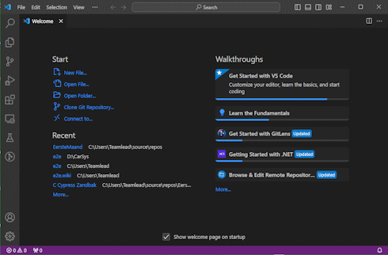
Onboarding
Onboarding materials
Test Script
Coding Tool
Browser&DevTools

Slide 32
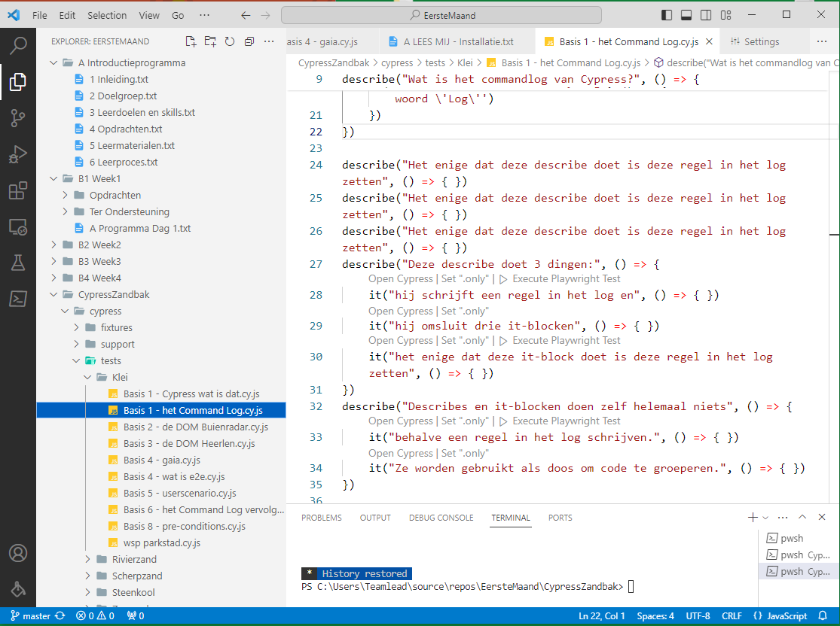
Onboarding
This is a screenshot of the program the student receives. It only exists in VSCode and consists of:
a folder structure with plain text files containing the coursework and resources
a folder containing a Cypress Sandbox with example scripts ready to run.

Slide 33
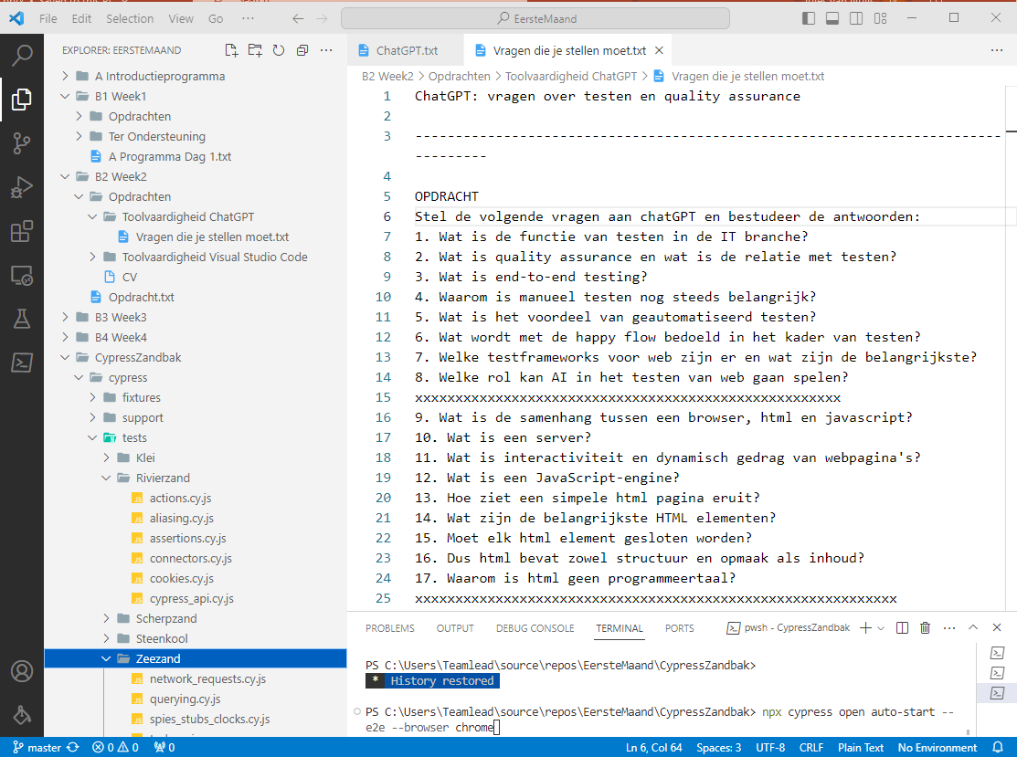
Onboarding
Another screenshot of the program.

Slide 34

Onboarding
More…
Our Onboarding Kit will soon be available on Github (including the first test project of a group of 4 new students who absolved the program).
Test Script
Coding Tool
Browser&DevTools

Slide 35
Onboarding
And that is

Slide 36
Onboarding
The End
The End

